Slide 1
Data Analysis
Tea Time: Feb 22 2019

Slide 2
Quick Prep
Please, take a few minutes to download the data for today:
1) Go to
GITHUB LINK: https://github.com/lingerxu/FLOdoesScience
2) Click tea_time_data.xlsx
3) Click Download, and open file in Excel

Slide 3

… and develops a hypothesis
Do children who play more, develop faster?
Specifically, do they learn words better?
Notes:
Does playing with objects help children learn words?

Slide 4

The story
Flo & Dexter do research on child-parent play
Notes:
What are the two measures?

Slide 5
The story
Hypothesis :
children who play more will learn more words
Notes:
After reading …What are the two measures?

Slide 6
The experiment
Design:
Dyadic play
2 measures:
play - time manipulating objects
Language – MCDI
Longitudinal:
12mo & 24mo
Hypothesis :
children who play more will learn more words
Concrete prediction:
children who manipulate objects longer at 12 mo have higher MCDI scores at 24mo

Slide 7
Alternative prediction
P
MCDI scores
C
Notes:
What are some other predictions, or possible hypotheses

Slide 8
Data Analysis -
?
Yes/No
Test
infants' object manipulation at 12 month
MCDI score at 24 months
=

Slide 9
Correlation
Testing whether there is a relationship between variables
Do infants' object manipulation at 12 month predict their MCDI score at 24 months?
infants' object manipulation at 12 month
MCDI score at 24 months

Slide 10
Correlation
Pearson correlation : Measuring the strength of a relationship
represented by the coefficient R or R² :
infants' object manipulation at 12 month
MCDI score at 24 months
0.3
0.5
0.7
Weak Moderate Strong
Positive Negative

Slide 11
Correlation
^{How? Insert excel functions}
^{R : =CORREL( V1, V2)}
^{N: =COUNT(V1)}
P : =1-F.DIST(((R^2)*(N-2)/(1-R^2)), 1, N-2, TRUE)
infants' object manipulation at 12 month
MCDI score at 24 months

Slide 12
T-Test
Testing whether two groups are different
Do High & Low infants' object manipulation at 12 month have different MCDI score at 24 months?
High infants' object manipulation at 12 month
MCDI score at 24 months
=
Low infants' object manipulation at 12 month
MCDI score at 24 months
Notes:
We comparing two groups
Dividing data set to 2 groups

Slide 13
T-Test
Two-Sample, one-tailed, assuming equal variance : measuring difference between the means of two groups represented in the coefficient t
High infants' object manipulation at 12 month
MCDI score at 24 months
=
Low infants' object manipulation at 12 month
MCDI score at 24 months
Notes:
We comparing two groups
Dividing data set to 2 groups

Slide 14
T-Test
Two-Sample, one-tailed, assuming unequal variance: measuring difference between the means of two groups represented in the coefficient t
^{How? Insert excel functions}
¹⁾
R : =T.TEST( V1, V2,tail, type)
^{P: =TTEST(V1, V2,tail, type)}
^{2) Analysis ToolPack}
Notes:
We comparing two groups
Dividing data set to 2 groups

Slide 15
T-Test
2.
Open data in excel!
Click the top Tool menu -> Excel Add Ins -> select Analysis ToolPack
top tool bar click the Data tab
Click Data Analysis
Choose correlation
3
4

Slide 16
Correlation
infants' object manipulation at 12 month
MCDI score at 24 months
T-Test
High infants' object manipulation at 12 month
MCDI score at 24 months
=
Low infants' object manipulation at 12 month
MCDI score at 24 months

Slide 17
Data Analysis -
?
Yes/No
Test
infants' object manipulation at 12 month
MCDI score at 24 months
=

Slide 18
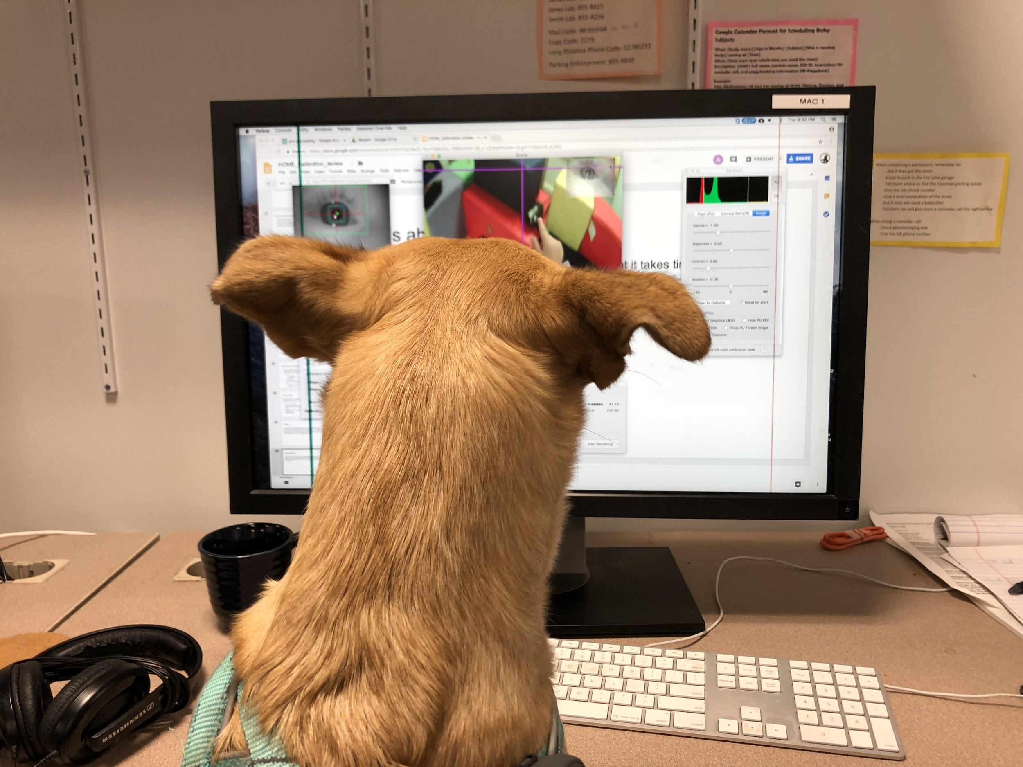
What’s Next?
Flo plans to report results to ICIS as abstract and collect more data
Decide for next tea time: R, Matlab, python or continue exploring Excel ?

Slide 19
Correlation
http://statisticsbyjim.com/regression/interpret-r-squared-regression/
https://www.dummies.com/education/math/statistics/how-to-interpret-a-correlation-coefficient-r/
https://www.youtube.com/watch?v=Vy7FgKd9uPQ
https://www.youtube.com/watch?v=qx3vr_duVg8

